Slide 1
Oracy in Action Module 1, Unit B
Lesson 1B: Argumentation

Slide 2
Which do you prefer?
Ice skating or Roller blading?
A: I prefer…
C: Because…
B: Why?

Slide 3
Which do you prefer?
Breakfast or Dinner?
A: I prefer…
C: Because…
B: Why?

Slide 4
Now, make up your own and ask your partner…
________________?
A: I prefer…
C: Because…
B: Why?

Slide 5
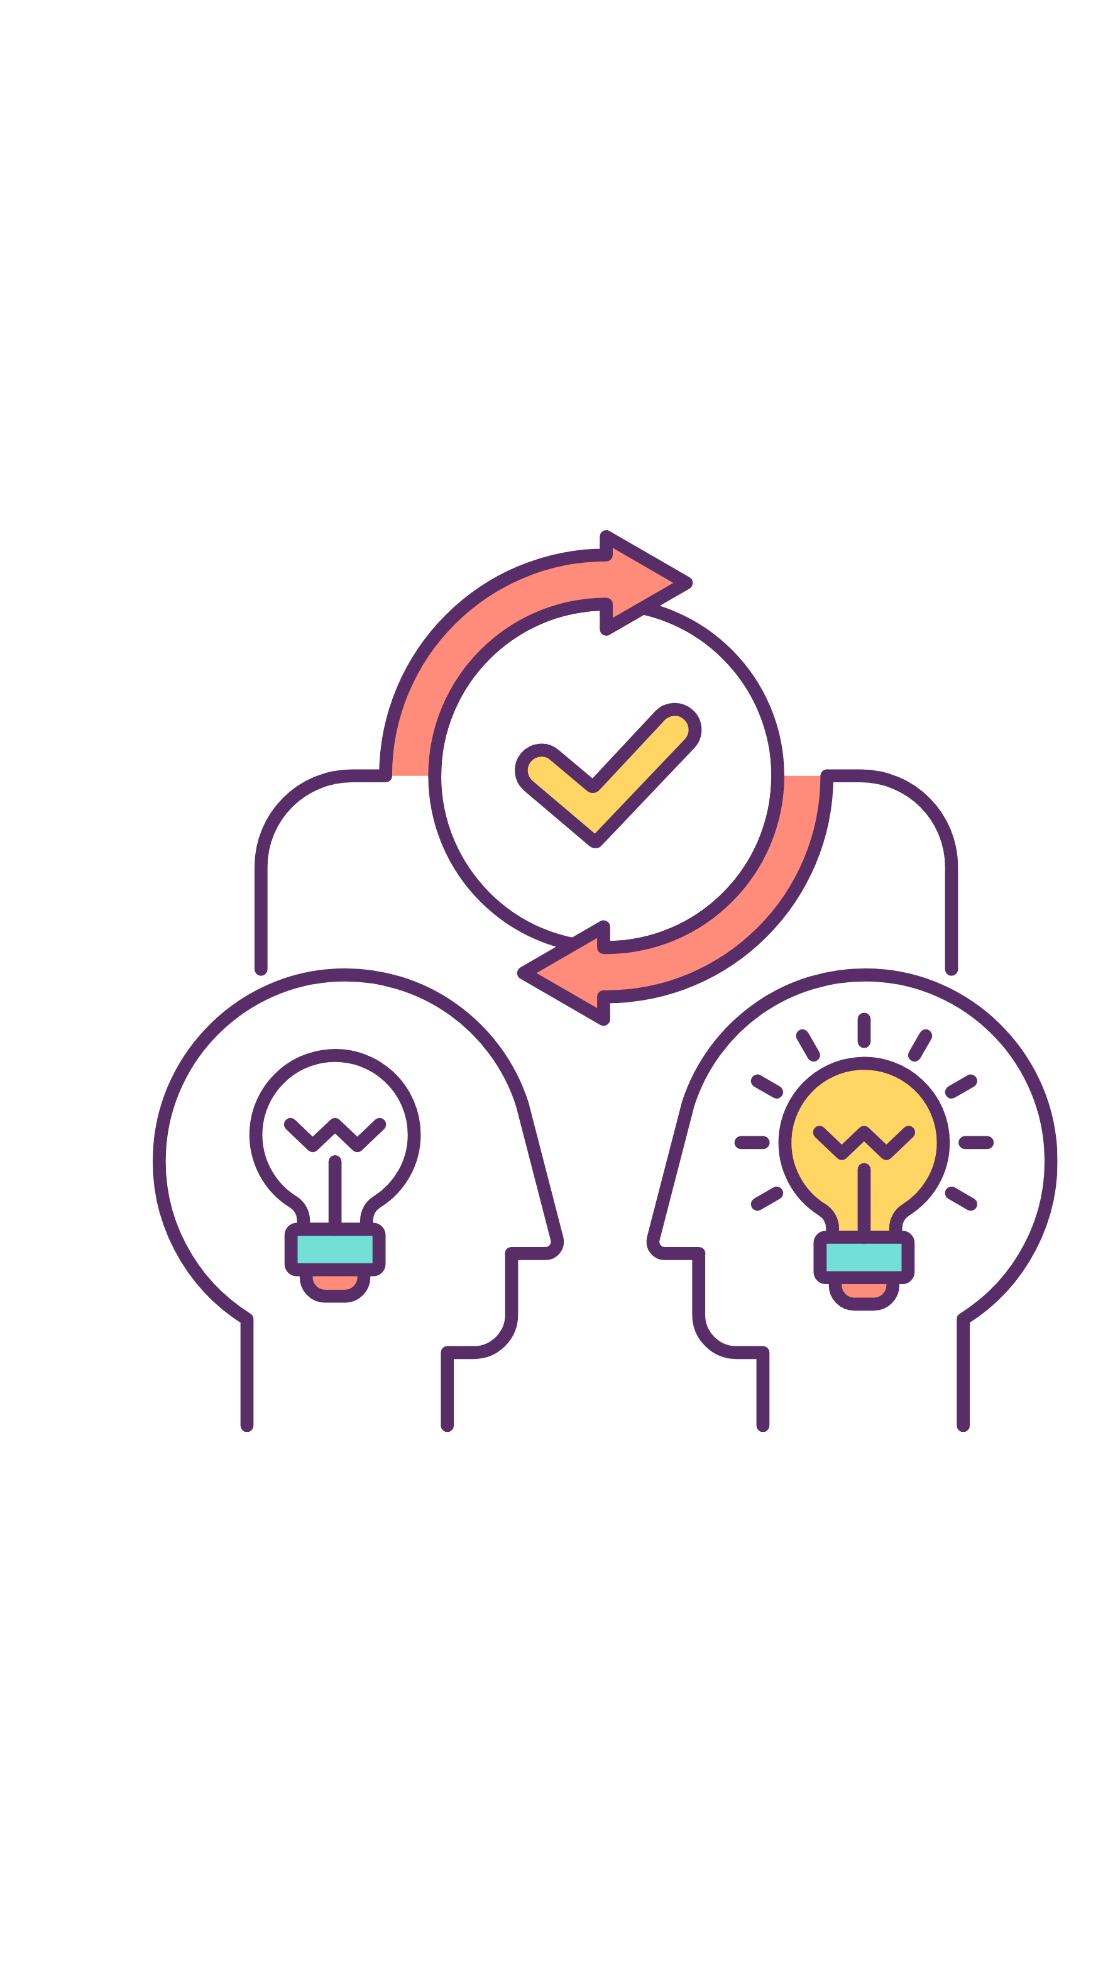
Justifying opinions
Think Pair Share
Why is it important to justify our opinions?
How does it help us in our interactions and relationships with others.
How will providing justification for our opinions help us when persuading others and when developing balanced arguments?

Slide 6
PEE
POINT | The reason you support or oppose a topic
EXPLANATION | The ‘because’ reasoning that supports your POINT
EXAMPLE | An example that supports your EXPLANATION and POINT

Slide 7
PEE
POINT | Fast food is unhealthy. | The reason you support/ oppose a topic.
EXPLANATION | Fast food is unhealthy because it contains a lot of fat, salt and sugar, which can cause lots of different problems such as diabetes and obesity. Fast food is tasty so people eat too much. | Describe why your POINT is true. If you don’t know what to say, ask WHY your point is true and start your answer with BECAUSE.
EXAMPLE | A McDonald’s Big Mac has 540 calories and 29 grams of fat, nearly a third of your daily fat allowance. | Facts or real-life examples that support your EXPLANATION and POINT.

Slide 8
Time to practice
Can you think of your own Explanation and Example for or against these Points?
Point: Dogs are better than cats
Point: We should be allowed to elect our own headteacher.
Point: We shouldn’t use plastic anymore because it’s bad for the environment

Slide 9
Where do YOU stand?
Do you agree or disagree with the following statement?
Dogs are better than cats
Agree
Stand up!
Disagree
Sit down!
Hands on desk

Slide 10
Where do YOU stand?
Do you agree or disagree with the following statement?
We should be allowed to elect our own headteacher
Agree
Stand up!
Disagree
Sit down!
Hands on desk

Slide 11
Where do YOU stand?
Do you agree or disagree with the following statement?
We shouldn’t use plastic anymore because it’s bad for the environment
Agree
Stand up!
Disagree
Sit down!
Hands on desk

Slide 12
Time to evaluate…
What Went Well?
Even Better If…
In my opinion…
I think that…
I believe that…
I varied…
I tried…
I listened…
Notes:
Open discussion pitched at the correct level.

Slide 13
Lesson 2B: Argumentation and Response

Slide 14
Summaries - Let’s do one together
Summary:
You said _________________________________________________

Slide 15
Summaries - Your turn
Summary:
You said _________________________________________________

Slide 16
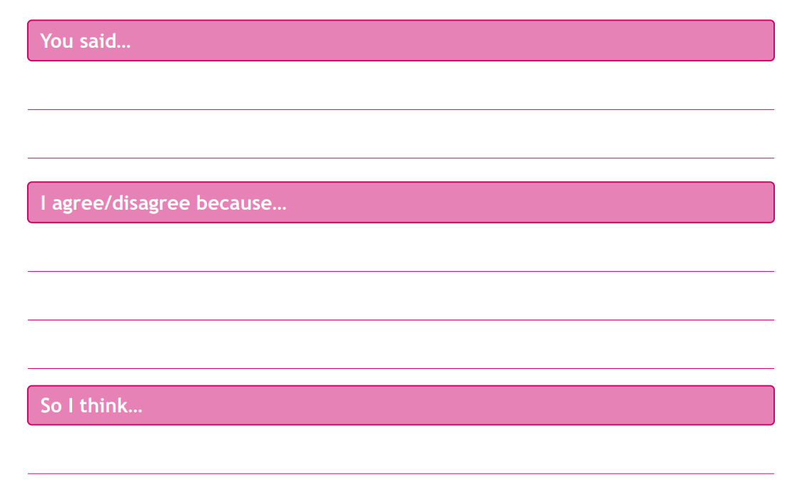
P: Fast food is unhealthy
E: because it contains a lot of fat, salt and sugar, which can cause lots of different health problems.
E: For example, in America fast food is very popular, and as a result the population has a high rate of obesity.
Writing Frame
Rebuttal

Slide 17
P: School should finish at lunchtime
E: because it limits the amount of social activities children can do in a day
E: For example, in Spain, school finishes earlier so that children can focus on clubs such as sport or music in the afternoons
Writing Frame
Rebuttal

Slide 18
Can you see the other side?
In pairs, pick one of these topics and develop arguments and responses for both sides of the issue.
Be prepared to share your work with the class!
Henry VIII
Global Warming
School dinners
School uniform
The Romans
WW2

Slide 19
Plenary
Rank the PEE arguments from least to most effective.
Be prepared to share your reasons with the class!

Slide 20
Lesson 3B: Information selection

Slide 21
Can you identify…
The Point, Explanation and Example?
There are TWO PEE arguments here!
My point in the debate is that if we choose our own books to learn from, we’ll have more fun at school.
In the last World Cup all the players supported each other as a team and had a lot of fun.
Playing basketball is better than going swimming because it’s a team sport.
It’s much more fun to do something as a team than on your own, you have lots of friends to play with.
For example, I would love to read Diary of a Wimpy Kid.
Books we’ve chosen ourselves will be exciting and fun!

Slide 22
Correct your answers!
1
2
P: My point in the debate is that if we choose our own books to learn from, we’ll have more fun at school.
E: Books we’ve chosen ourselves will be exciting and fun!
E: For example, I would love to read Diary of a Wimpy Kid.
P: Playing basketball is better than going swimming because it’s a team sport.
E: It’s much more fun to do something as a team than on your own, you have lots of friends to play with.
E: In the last World Cup all the players supported each other as a team and had a lot of fun.

Slide 23
Argument Jigsaw
Get into groups of four or five.
You will be given a resource pack containing a motion and three supporting and opposing arguments that have been broken down into their individual elements.
Each group must match the individual elements to create three whole arguments.
You will then decide who will present the different arguments and will practice delivering these .
You will then present your arguments to the class, making good use of non-verbal cues.
You will then evaluate each other's work!

Slide 24
Plenary
Example Top Trumps!
Which of these Examples is BEST at supporting the argument?
P: Zoos let us see animals we would never otherwise see
E: Having a pet teaches you to be responsible because you must look after it. Your pet depends on you.
E:
A hamster needs to be fed every day
My mum walks my dog for me
Farmers must feed and care for all their animals

Slide 25
Plenary
Example Top Trumps!
Which of these Examples is BEST at supporting the argument?
P: Everyone should have a pet to learn to become more responsible
E: Rare and endangered animals are very hard to see in the wild. It is educational to see these creatures and makes us more likely to protect their habitats.
E:
Pig
Buffalo
Tiger

Slide 26
Plenary
Example Top Trumps!
Which of these Examples is BEST at supporting the argument?
P: Wearing home clothes is more comfortable than wearing a uniform
E: We all find different clothes comfortable, so we should be allowed to wear what we want.
E:
Jeans
Pyjamas
Princess dress

Slide 27
Plenary
Example Top Trumps!
Which of these Examples is BEST at supporting the argument?
P: Children shouldn’t have phones because they can be distracting
E: Some people are on their phones all the time – they may have messages from friends they want to check. But this means they are a bit distracted all the time, and they miss out on the things going on around them.
E:
Using a phone during lessons
Using a phone during meal times
Using a phone whilst a friend is talking to you

Slide 28
Plenary
Example Top Trumps!
Which of these Examples is BEST at supporting the argument?
P: Sports in school should be voluntary
E: If sports was voluntary, some people could choose to learn other skills during that time such as…
E:
Juggling
Cooking
Football

Slide 29
Plenary
Example Top Trumps!
Which of these Examples is BEST at supporting the argument?
P: We should close all the fried chicken shops so people would eat healthy food
E: Fried chicken is tempting, even though it is not a healthy meal. People would eat a more nutritious diet if there were only healthy alternatives like…
E:
Salad, salad and more salad!
Crisps and chocolate
Grilled chicken and vegetables

Slide 30
Lesson 4B: Stakeholders

Slide 31
Stakeholders
The people affected by a motion are called STAKEHOLDERS.
Because they are affected in different ways, they have different interests.

Slide 32
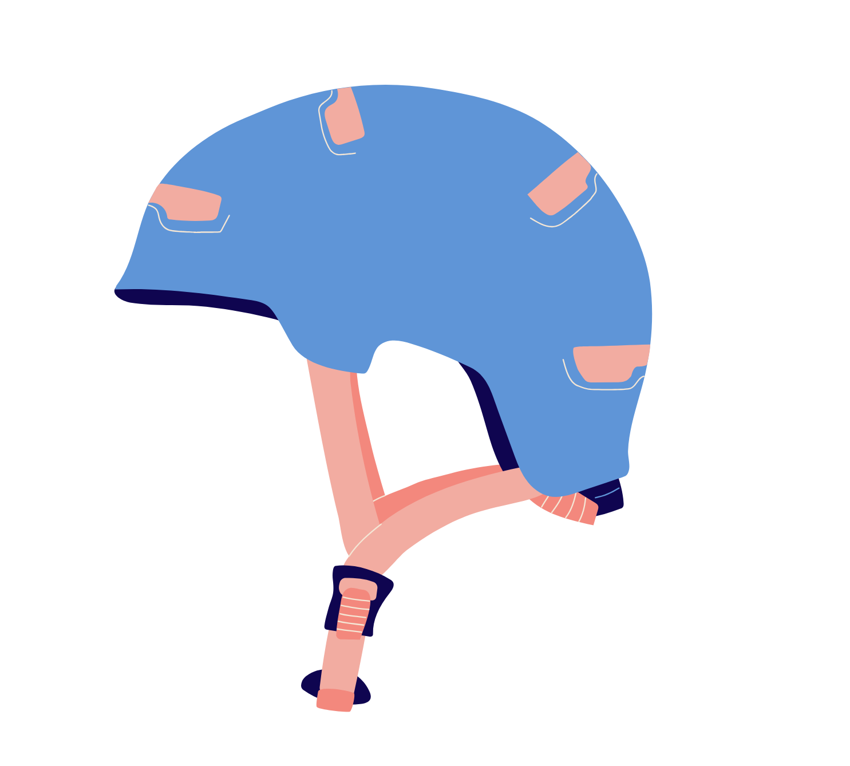
Stakeholders and Motions
For a motion about making cycle helmets mandatory for everyone under 18, stakeholders would be:
medical professionals
road safety organisations
Children
Parents
police.

Slide 33
Stakeholders and motions
For a motion about banning the sale of sweets to under 14 year olds, the stakeholders would be:
Children under 14
Shop owners
Dentists
Parents
Confectionary companies

Slide 34
Stakeholder Story
Get into a group of 4.
Work through a ‘Choose your own adventure’-style story.
At key points, each group will have to assume the role of a stakeholder and consider how they are affected by the decision under discussion.
You should prepare a statement for the class explaining which option is best/worst for their stakeholder, and why.
The class will then vote, and the story will progress accordingly.
Stakeholders’ views impact the arguments you make. Our voting needs to be based on the strength of the argument presented in each case.

Slide 35
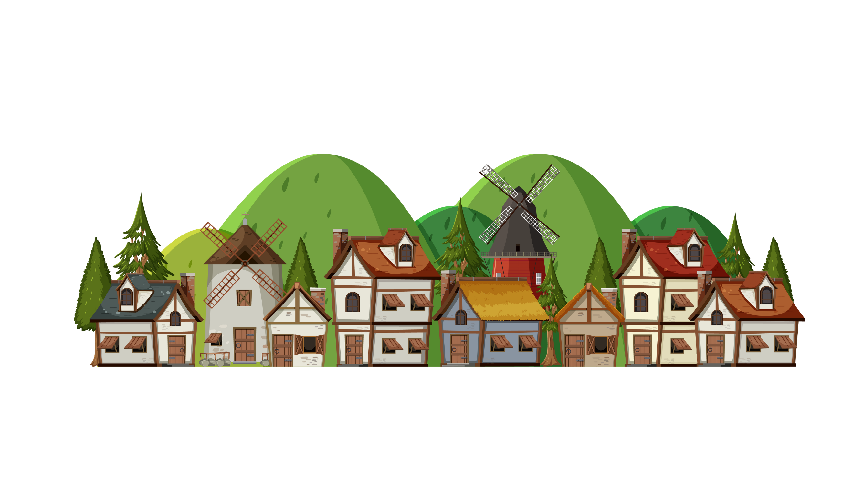
Stakeholder Story
Once upon a time, in a land far, far away, there was a rugged band of adventurers. There was a dragon called Dragon, a mouse called Mouse, a goat called Goat and a giant called Tiny.
They lived in a little village. For a long time, the village had been slowly running out of food. Every year, they planted fruit and vegetables, but less and less grew.

Slide 36
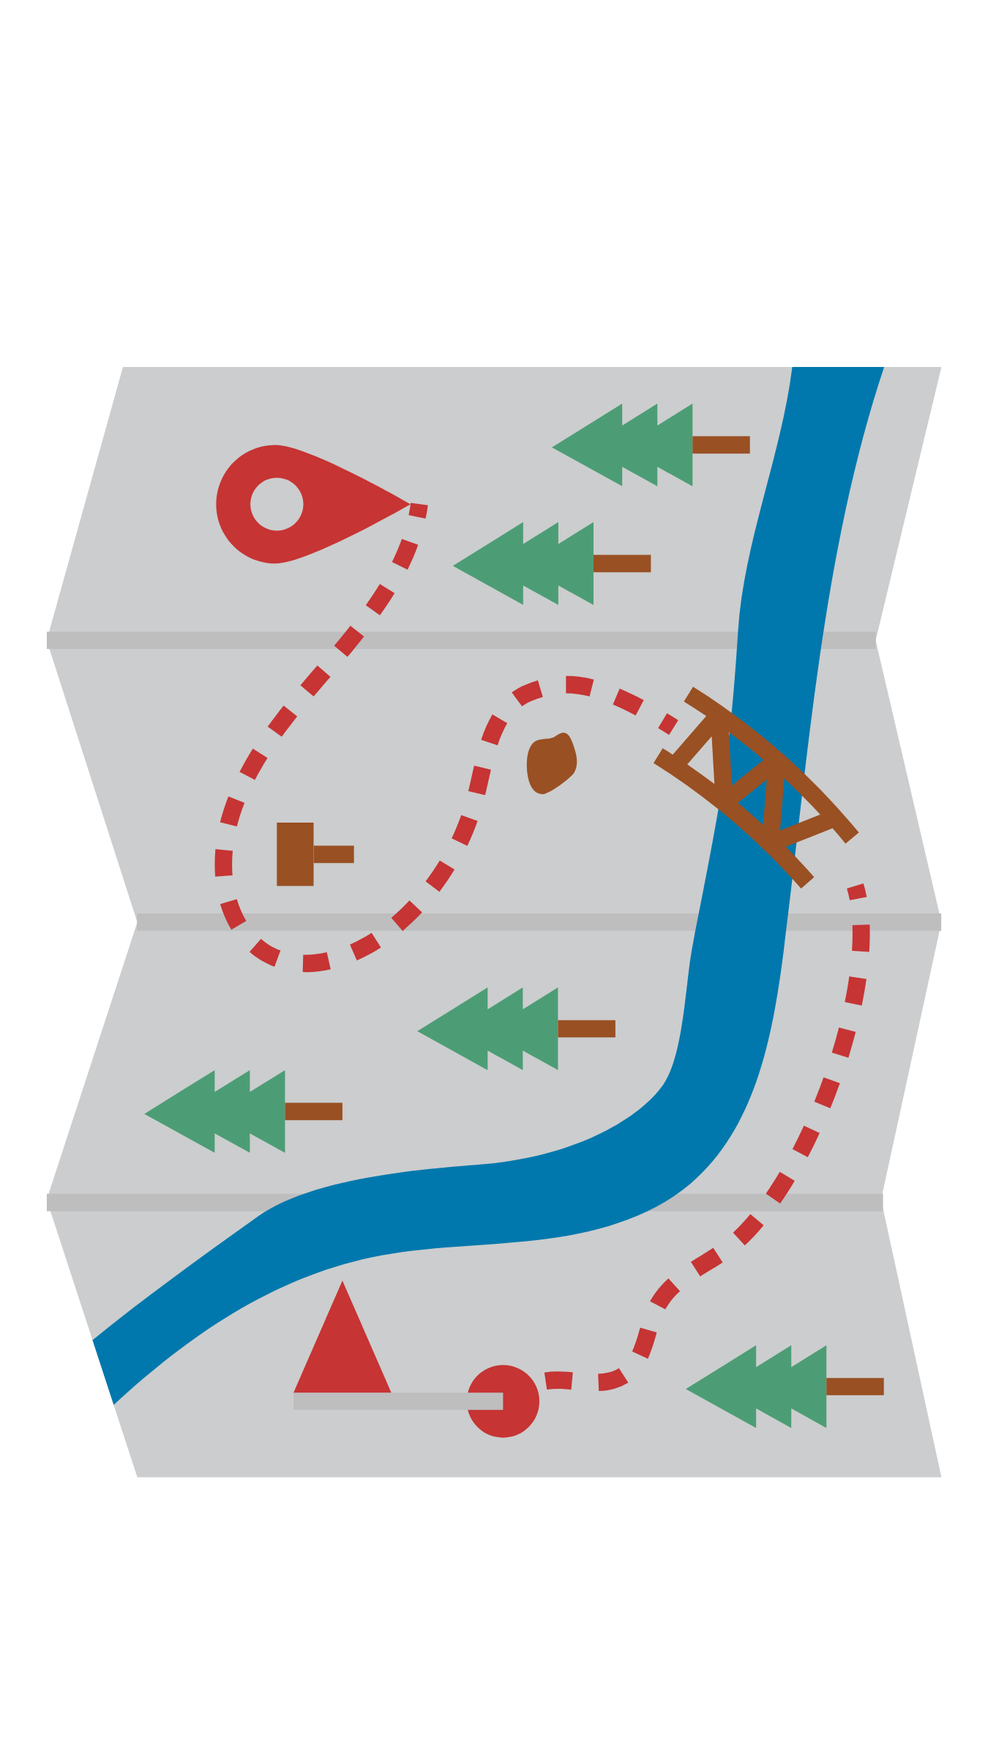
Stakeholder Story
One day, the rugged adventurers decided to set out on a quest to solve this problem. First, they had to decide which way to go – one road leading out of the village was up a steep, rocky mountain. The other was flat, but involved crossing many rivers.
Choose an adventurer – how do you feel about each road?
[If you choose the steep road go forward one slide. If you choose the long road go forward two slides.

Slide 37
Stakeholder Story
They climbed the steep, rocky mountain for three days, and three nights.
Then, they came across a unicorn, a farmer and a bird arguing in a field.
[Go forward 2 slides]

Slide 38
Stakeholder Story
They walked for three days and three nights, crossing many rivers and fording many streams.
Then, they came across a unicorn, a farmer and a bird arguing in a field.
[Go forward one slide]

Slide 39
Stakeholder Story
“Why are you arguing?” asked Mouse.
The farmer replied, “The unicorn keeps trampling my crops – every morning I find fresh hoofprints in my field, and my vegetables are all destroyed! How will I feed my family now?”
The unicorn snorted angrily, and said, “I have always scratched my mane against that tree – it’s not my fault that the farmer planted so many vegetables in the field this year!”
The bird asked, “Can you help us? The farmer is threatening to cut down the tree, to force the unicorn to scratch somewhere else. But I live in that tree – it is my home! What should we do?”
Choose one stakeholder – the farmer, the unicorn or the bird. What do you think they should do?

Slide 40
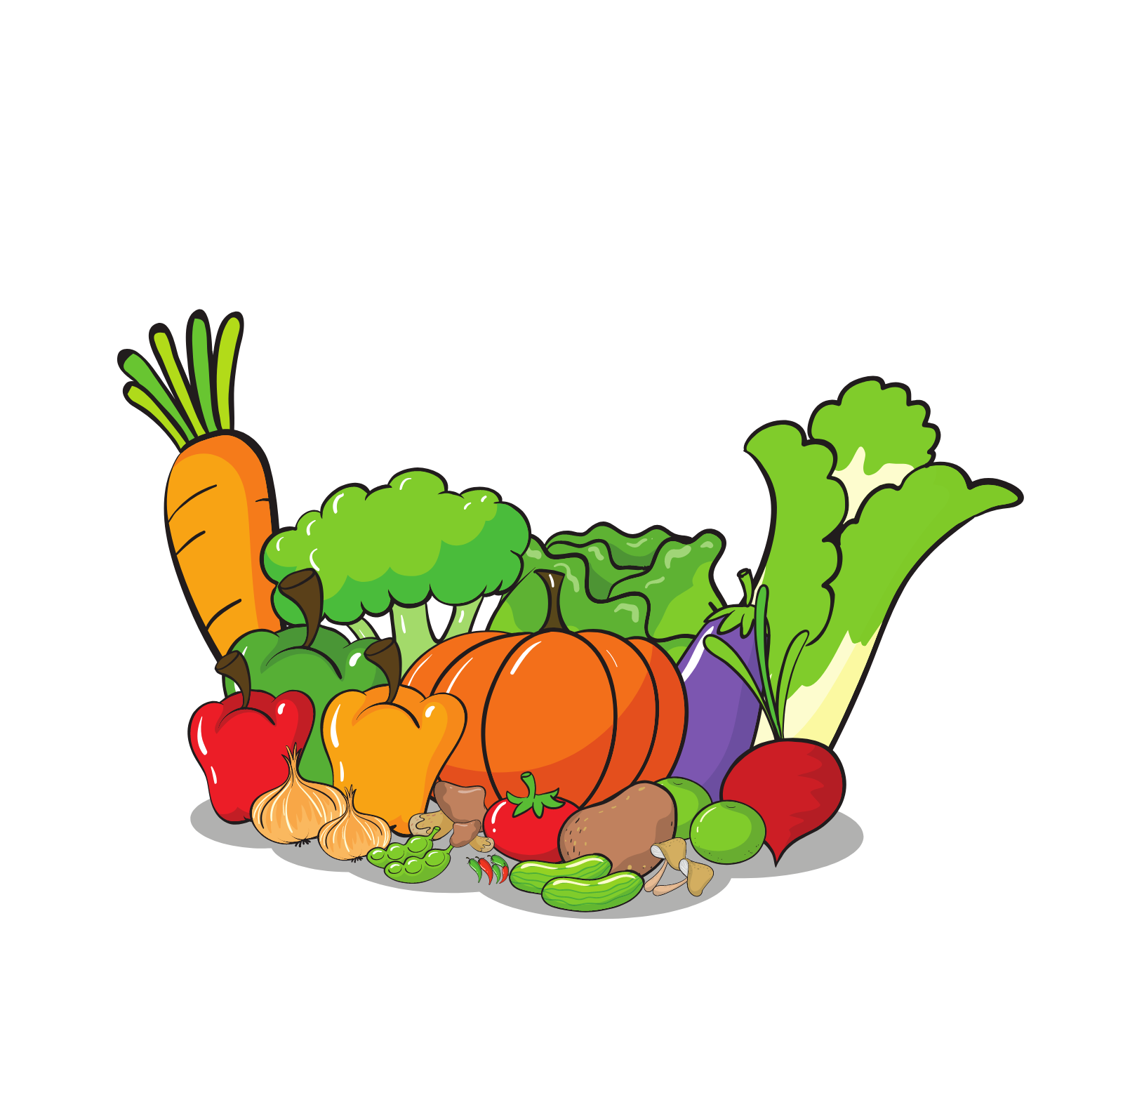
Stakeholder Story
The rugged adventurers continued on their journey. To thank them for their help, the farmer promised to send a sack of vegetables to their village. The bird promised to send some seeds, and the unicorn promised to make those into Magic Seeds that would grow even in the harshest weather, or the thinnest soil.

Slide 41
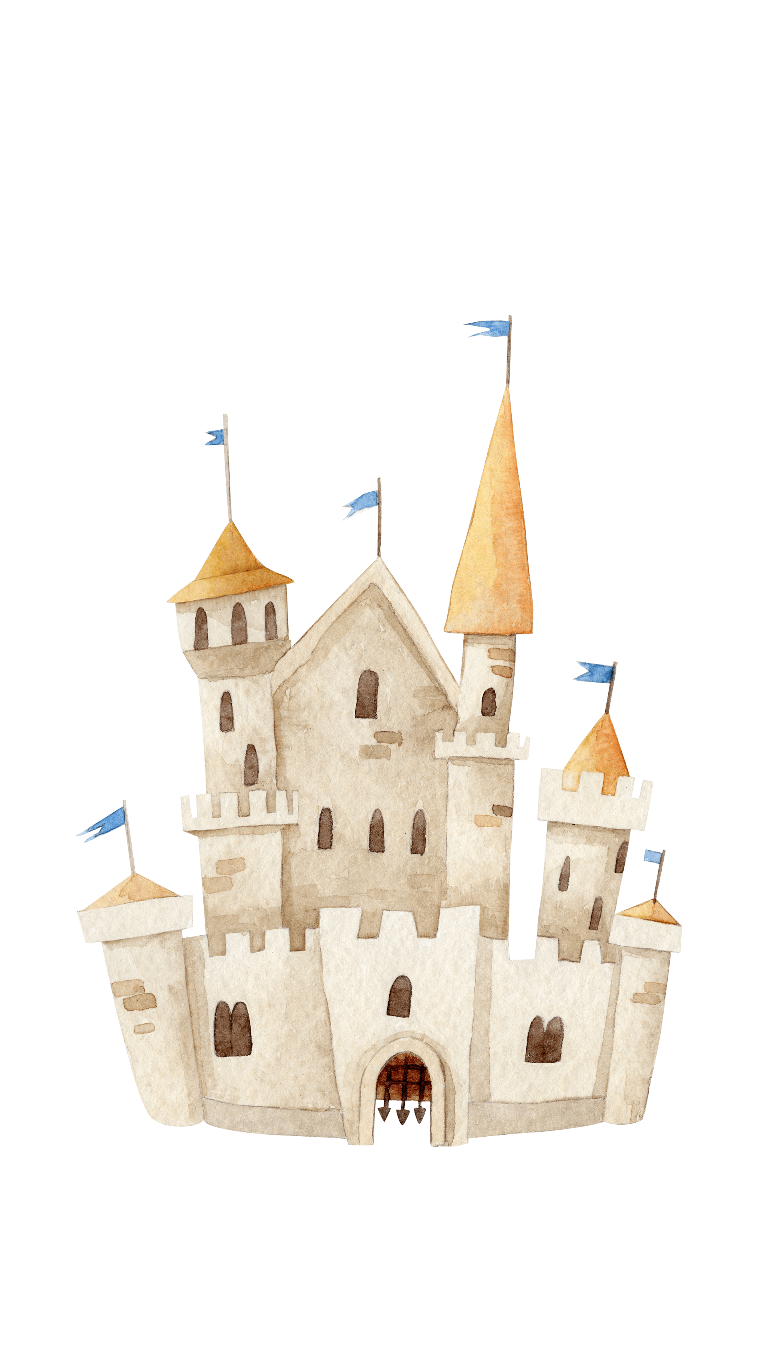
Stakeholder Story
In the distance, the rugged adventurers saw a gleaming castle. As they approached, a messenger ran to greet them.
“I’m so happy you’re here!” cried the messenger, “Quick, the High Council want to speak to you at once.”
They hurried through the castle grounds – Tiny and Dragon had to be very careful not to step on anyone – and soon they reached the Council Chamber.
Dragon gulped, nervously, and was careful not to sneeze, as the whole Chamber was made from wood, and Dragon didn’t want to set it on fire.

Slide 42
Stakeholder Story
“We have a problem” said the leader of the High Council, “and I hear that you adventurers are good at solving problems. Can you help us?”
“We’ll try – what’s wrong?” asked Goat.
“The Duke, who owns this castle, hates the sound of any music. It gives him a horrible headache. So he’s banned anyone from singing or playing instruments. But now, lots of the people living the castle are very unhappy! We used to have lots of parties and dances, but now we don’t any more.”
Choose a stakeholder – the duke, the musicians in the castle, and the other inhabitants of the castle. What should they do?

Slide 43
Stakeholder Story
The High Council was so happy with the adventurers that they gave them so much food that even Tiny could not carry it all. Happy that this would feed their village for a long time, the adventurers headed home…

Slide 44
Who is the odd one out?
We should ban zoos
Wild animals
Zoo animals
Conservationists
Astronauts
Zoo staff

Slide 45
Who is the odd one out?
Nobody should have to wear school uniform
Pupils
Police officers
Parents
Teachers
Bullies

Slide 46
Who is the odd one out?
Do celebrities make bad role models?
Well-behaved celebrities
Pet dog
Police officers & fire fighters
Children
Naughty celebrities

Slide 47
Who is the odd one out?
Primary pupils should not be given homework
Pupils who ace the work
The owner of the local newsagent
Teachers
Older siblings & family
Pupils who find the work difficult

Slide 48
Who is the odd one out?
The advertising of fast food should be banned
Doctors and health experts
People who like fast food
People who eat too much fast food
Tobacco companies
Fast food companies

Slide 49
Lesson 5B: Preparing for a balloon debate

Slide 50
Don’t interrupt!
Split into groups of six and stand in a circle, facing inwards.
Going around the circle, count to 15 clockwise and in order.
Now, we will try again. Although the numbers will go up in order, anyone can say them at any time! Try your hardest not to interrupt one another!
If at any point two pupils speak at the same time or get a number wrong, the group must start again.
Every group will get to practice, then we will have a timed round – the fastest group is the winner.
Extension:
Have another go, but this time face outwards. Why do you think it’s so much more difficult?

Slide 51
Can you explain these in your own words?
The four key skillsets
Reasoning & Evidence | Organisation & Prioritisation | Expression & Delivery | Listening & Response
?
?
?
?

Slide 52
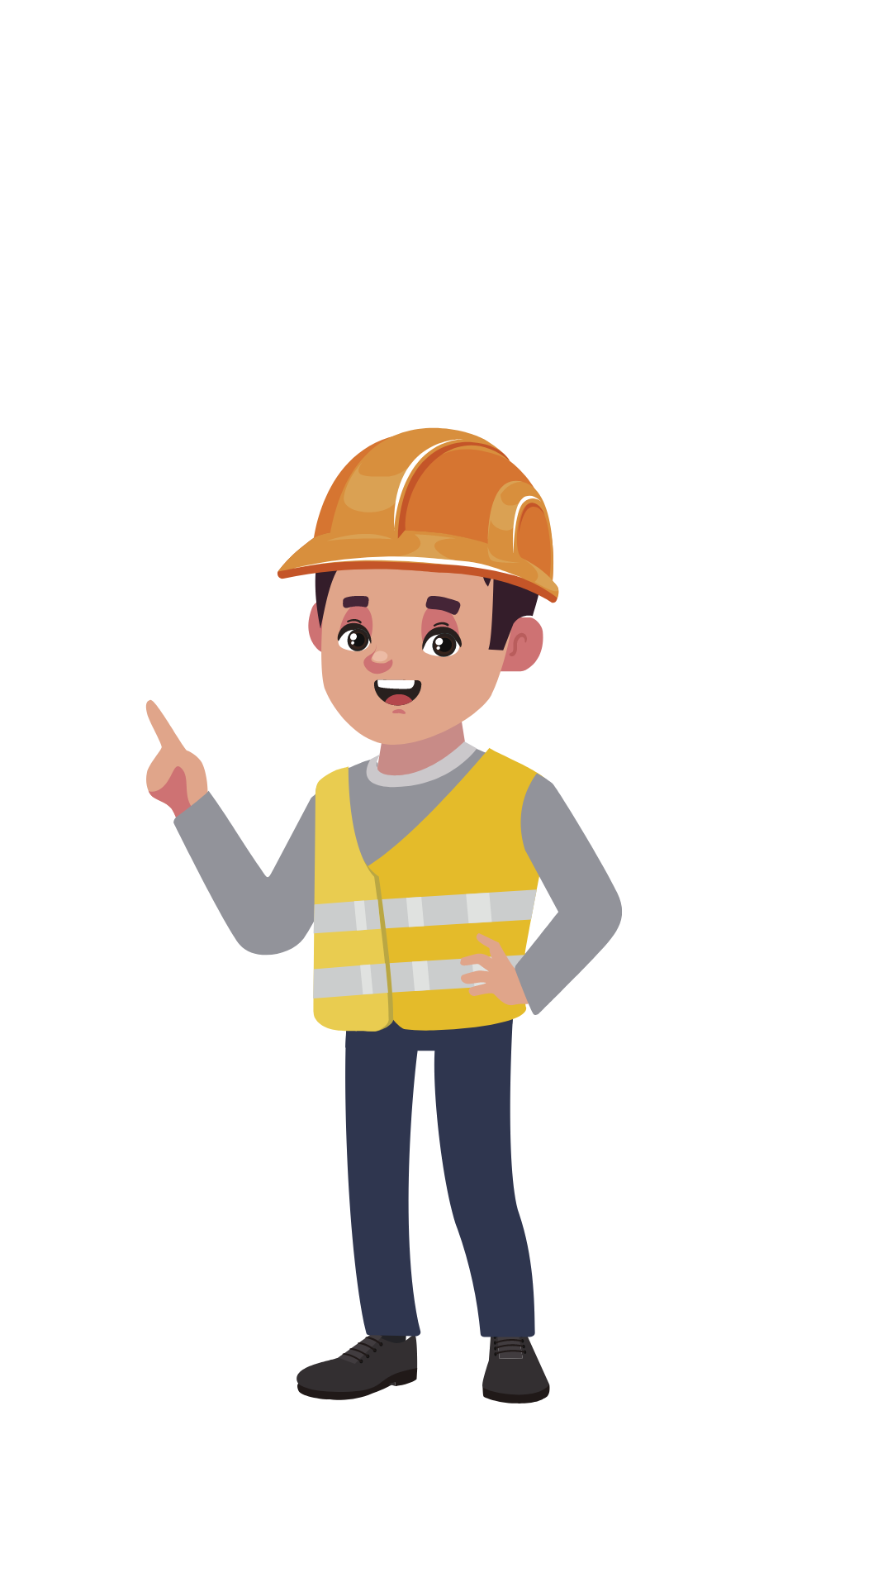
Balloon Debate
We are in a hot air balloon, flying over dangerous shark-infested waters. The balloon starts running out of air and is beginning to sink.
To survive, we must throw one person overboard.
Who should it be?

Slide 53
Preparation
Motion for the Balloon Debate:
All cars should be banned from city centres.
Which groups are the stakeholders in this debate?
?
?
?
?
?

Slide 54
Balloon Debate Roles
Each group is going to represent one stakeholder in a balloon debate on the motion. Each group will need to prepare their arguments. In order to do this effectively you will need to assume different roles:
The Chair’s job is to make sure the group doesn’t all talk at once, and ensure no-one is left out
Scribe 1 will write down argument 1
Scribe 2 will write down argument 2
Scribe 4 will write down the brainstorm
Everyone else will be a contributor
Scribe 3 will write down argument 3

Slide 55
Next Steps
Have a think about the stakeholder you have been allocated. Brainstorm and share your ideas in your groups.
Decide whether your stakeholder is for or against the motion.
Choose three arguments and begin developing PEE for the first argument using the ‘argument’ sheets.
Develop PEE for the second argument and third argument.
Read through your work and check it matches whether your stakeholder is for/against the motion, and add any final thoughts.
Decide who will represent your stakeholder view in the balloon and give that person the opportunity to practise putting across their argument, providing feedback on expression, confidence and clarity. Use the ‘body language’ sheets for guidance

Slide 56
Plenary
Practice makes perfect!
Join another group and try out your speeches, providing feedback for each other.
Try to reflect on how you are using each skillset!
Reasoning & Evidence | Organisation & Prioritisation | Expression & Delivery | Listening & Response

Slide 57
Lesson 6B: Balloon Debate

Slide 58
Can you match the terms to their meaning?
Point | A response that disagrees with the other sides argument
Explanation | The reason you support or oppose a topic
Example | The ‘because’ reasoning that supports your point
Rebuttal | A short question or point during the other sides’ speech
Point of information | A fact or story that supports your explanation and point

Slide 59
Balloon Debate
All cars should be banned from city centres.
Each representative will take their place inside the balloon and will take turns to present their first point.
The audience will write down key ideas and evaluate performances using PEE.
A vote will be taken on who to throw out of the balloon.
The remaining candidates will present their next point, and voting and elimination will take place again.
This will happen again, until only the winner is left in the balloon!

Slide 60
High FIVE!
With a partner, discuss for each finger:
One thing you did well today
One thing you could improve on
One new thing you have learn this term
One goal you will set for the future
What oracy means to you

