Slide 1
Oracy in Action Module 1, Unit A
Lesson 1A: Introduction to oracy

Slide 2
What does it mean?
Oracy
‘Sir Winston Churchill is considered to have been a great orator’
‘Good levels of oracy help us to explain ourselves clearly’
‘Oracy includes having good levels of vocabulary’
‘Oracy helps us to be good listeners and hear other ideas clearly’
‘Oracy helps us in job interviews’
Being able to express yourself well, having the vocabulary to say what you want to say, and the ability to structure your thoughts so that they make sense to others.

Slide 3
Can you match the key words and definitions?
Evidence
Organisation
Prioritisation
Reasoning
Expression
to organise or deal with something according to its importance
the process by which you reach a conclusion after thinking about all the facts
a look on someone's face that conveys a particular emotion
the facts or information which are used to try to prove something
the way in which different parts are arranged or relate to each other.

Slide 4
Reasoning & Evidence | Organisation & Prioritisation | Expression & Delivery | Listening & Response
What ideas are you putting across? What examples are you giving? How are you convincing the audience with your words? | How clear are your ideas? How are you organising your ideas? Are you using sequencing words such as firstly, secondly etc? | How are you using your body? How are you using your voice? How are you convincing the audience without your words? | Are you listening respectfully? Are you taking turns? Are you including others? Are you asking meaningful questions?
The four key skillsets

Slide 5
Let’s discuss
You are going to watch two clips.
Whilst you are watching, think about how the speakers use their vocabulary, voice and bodies to communicate their point.
Can you identify parts of the skillsets?
Reasoning & Evidence | Organisation & Prioritisation
Expression & Delivery | Listening & Response
Video suggestions in notes
Notes:
Please search for the following video suggestions, (or feel free to look up your own!):
Lemons to lemonade | Senna
How a 13 year old changed 'Impossible' to 'I'm Possible' | Sparsh Shah

Slide 6
So… why is oracy important?
How does oracy help us in our every day life?
School
Home
Teams
Friends
Can you think of any examples?
How could it help us in the future?
Exams
University
Jobs
Relationships

Slide 7
High FIVE!
With a partner, discuss for each finger:
What oracy means to you
One new word you learnt today
The definition of that word
One skill you have learnt about
Your favourite part of the lesson

Slide 8
Lesson 2A: Introduction to reasoning, Part 1

Slide 9
Reasoning & Evidence | Organisation & Prioritisation | Expression & Delivery | Listening & Response
The four key skillsets
What ideas are you putting across?
Are you taking turns?
What examples are you giving?
How are you convincing the audience with your words?
Are you including others?
How are you using your body?
Are you asking meaningful questions?
How clear are your ideas?
Are you listening respectfully?
Are you using sequencing words such as firstly, secondly etc?
How are you organising your ideas?
How are you convincing the audience without your words?
How are you using your voice?

Slide 10
Today’s Plan
Today we are going to be starting to learn that it’s possible to argue with others well without falling out.
To do this, we need to express our point of view clearly and back it up with an explanation of why it is important.
This is such an important skill if we are going to develop good levels of oracy.

Slide 11
Balloon Debate
We are in a hot air balloon, flying over dangerous shark-infested waters. The balloon starts running out of air and is beginning to sink.
To survive, we must throw one person overboard.
Who should it be?

Slide 12
Balloon Debate
Save me!
I’m a policeman
Why?
Save me!
I’m an engineer

Slide 13
Balloon Debate
Why?
Save me because…
Save me because…

Slide 14
Balloon Debate
Save me because I can keep everyone safe.
My job is to keep order and fight crime. This means, if anything goes wrong I can keep cool and solve the problem. If I am thrown out, no one will be there to take charge!
Why?
Save me because I can fix things.
My job is to provide explanations or create new things to solve problems. This means, if anything goes wrong, I can repair it! If I am thrown out, there will be no one with my practical skills!

Slide 15
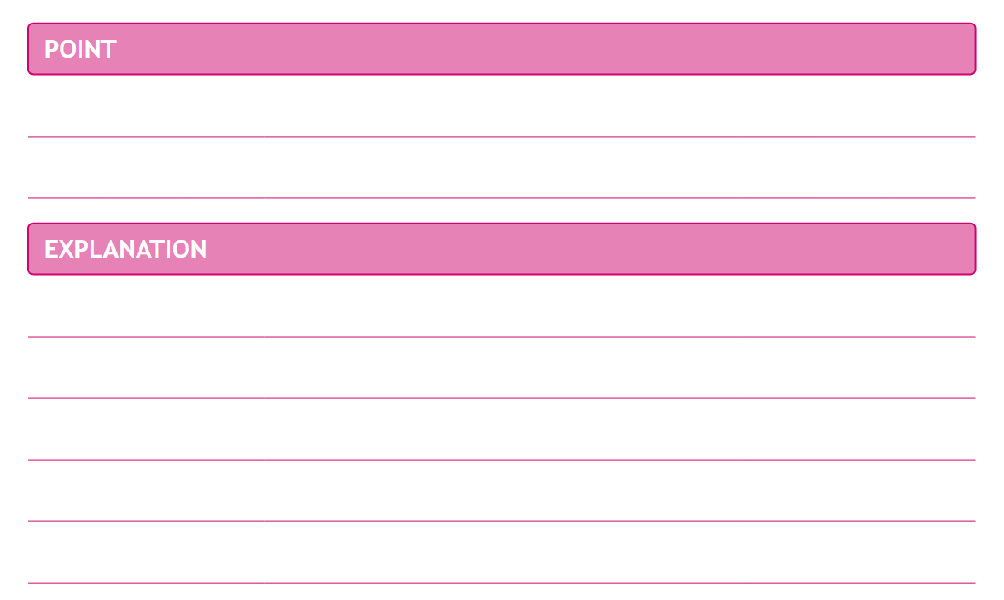
Balloon Debate
I shouldn’t be thrown out because I make people better when they’re sick.
Why?
People come to me when they are feeling unwell.
I treat and cure them with my medical knowledge, saving many lives!

Slide 16
Balloon Debate
Anne Frank: diarist of the Holocaust
Matilda Wormwood: clever child, occasionally telekinetic
Tim Peake: astronaut
Genghis Khan: nomadic warlord
David Attenborough: broadcaster and naturalist
Marie Curie: discoverer of radiation
Character lists
Confucius: teacher, politician and philosopher Barack Obama: ex-President of the United States Ernest Shackleton: Antarctic explorer
Ada Lovelace: mathematician and computer-scientist Tracy Beaker: creative rogue
Serena Williams: tennis player

Slide 17
Balloon Debate
Your turn!
Pick a character!

Slide 18
Plenary
What have you learnt so far?
You have one minute to write down everything you can about the importance of this skillset!
How did the activities today help you figure this out?
Reasoning & Evidence
Organisation & Prioritisation | Expression & Delivery | Listening & Response

Slide 19
Lesson 3A: Introduction to reasoning, Part 2

Slide 20
Teacher
I shouldn’t be thrown out because I can teach lots of new skills.
I help children to think, talk, and learn, which is important for growing up through school and beyond. If I am thrown out then pupils won’t learn as much, and they might grow up not able to spell or do sums.
Footballer
I shouldn’t be thrown out because fans enjoy watching my footballing skills.
My technique on the football pitch is special. Friends and families come together to celebrate when I score a goal. If you save me, I will score lots.
I shouldn’t be thrown out because my music makes people happy.
My songs are energetic and fun. This means that people want to dance to them, bringing joy and happiness to the world! If I am thrown out I won’t be able to make any more music, and people will be sad.
Popstar
Rank these points!
which ones are the most and least persuasive? Can you explain why?

Slide 21
Balloon Debate
We are in a hot air balloon, flying over dangerous shark-infested waters. The balloon starts running out of air and is beginning to sink.
To survive, we must throw one person overboard.
Who should it be?

Slide 22
Today’s Plan
Today we are building upon what we learnt last week about expressing our point clearly and backing it up with an explanation.
In groups, we will be preparing some of our classmates to be passengers in the balloon, helping them to develop and present reasons why they should be saved.
Then each of us will decide who should be saved, justifying our opinions in the ways we learnt about last week.

Slide 23
Balloon Debate
Anne Frank: diarist of the Holocaust
Matilda Wormwood: clever child, occasionally telekinetic
Tim Peake: astronaut
Genghis Khan: nomadic warlord
David Attenborough: broadcaster and naturalist
Marie Curie: discoverer of radiation
Character lists
Confucius: teacher, politician and philosopher Barack Obama: ex-President of the United States Ernest Shackleton: Antarctic explorer
Ada Lovelace: mathematician and computer-scientist Tracy Beaker: creative rogue
Serena Williams: tennis player

Slide 24
Balloon Debate
Time to prepare…
Get into your groups
Pick a representative from your group – this person will go into the balloon!
When you have been given your character, you will have ten minutes to prepare THREE reasons why your character must stay in the balloon.
Use the Point and Explanation system to structure your points clearly.

Slide 25
Balloon Debate
Put your skills to the test!
Each representative will take their place inside the balloon and will take turns to present their first point.
The audience will write down key ideas and evaluate performances using Point and Explanation.
A vote will be taken on who to throw out of the balloon.
The remaining candidates will present their next point, and voting and elimination will take place again.
This will happen again, until only the winner is left in the balloon!

Slide 26
Which do you prefer?
Swimming or Running?
A: I prefer…
C: Because…
B: Why?

Slide 27
Which do you prefer?
Tennis or Basketball?
A: I prefer…
C: Because…
B: Why?

Slide 28
Which do you prefer?
Cats or Dogs?
A: I prefer…
C: Because…
B: Why?

Slide 29
Which do you prefer?
Fish or Hamsters?
A: I prefer…
C: Because…
B: Why?

Slide 30
Which do you prefer?
Chips or Salad?
A: I prefer…
C: Because…
B: Why?

Slide 31
Which do you prefer?
Fruit or Chocolate?
A: I prefer…
C: Because…
B: Why?

Slide 32
Which do you prefer?
TV or Videogames?
A: I prefer…
C: Because…
B: Why?

Slide 33
Which do you prefer?
Summer or Winter?
A: I prefer…
C: Because…
B: Why?

Slide 34
Lesson 4A: Introduction to style

Slide 35
Structuring arguments
I’d rather eat salad than a pizza…
A lizard would be a great pet to have…
I wish the holidays lasted all year…
Why?
Because…

Slide 36
Today’s plan
In today’s lesson we’re going to build upon what we did last week by specifically thinking about how we can put our ideas and opinions across effectively.
We will identify the strategies - beyond the words used - that were most effective when delivering a speech.
We will then put this into practice!

Slide 37
Counting emotions
Anger: annoyed -> angry -> furious
Happiness: cheery -> happy -> delighted
Fear: anxious -> frightened -> terrified
Excitement: eager -> excited -> elated
Surprise: startled -> surprised -> astonished
Sadness: mopey -> sad -> distraught

Slide 38
What makes a persuasive speaker?
Eye-contact
Volume
Posture
Gesture
Tone
Pace

Slide 39
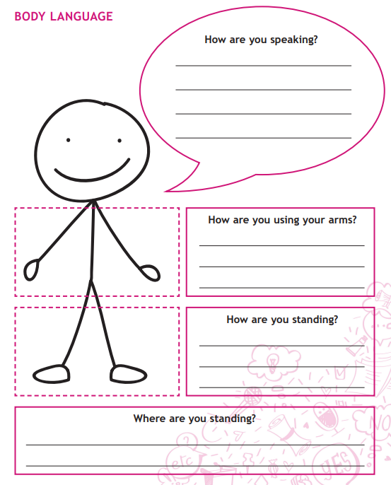
1. How could I improve my speech? Think beyond the words that I use.
2. Now, fill out your worksheet to include everything we have learnt so far.

Slide 40
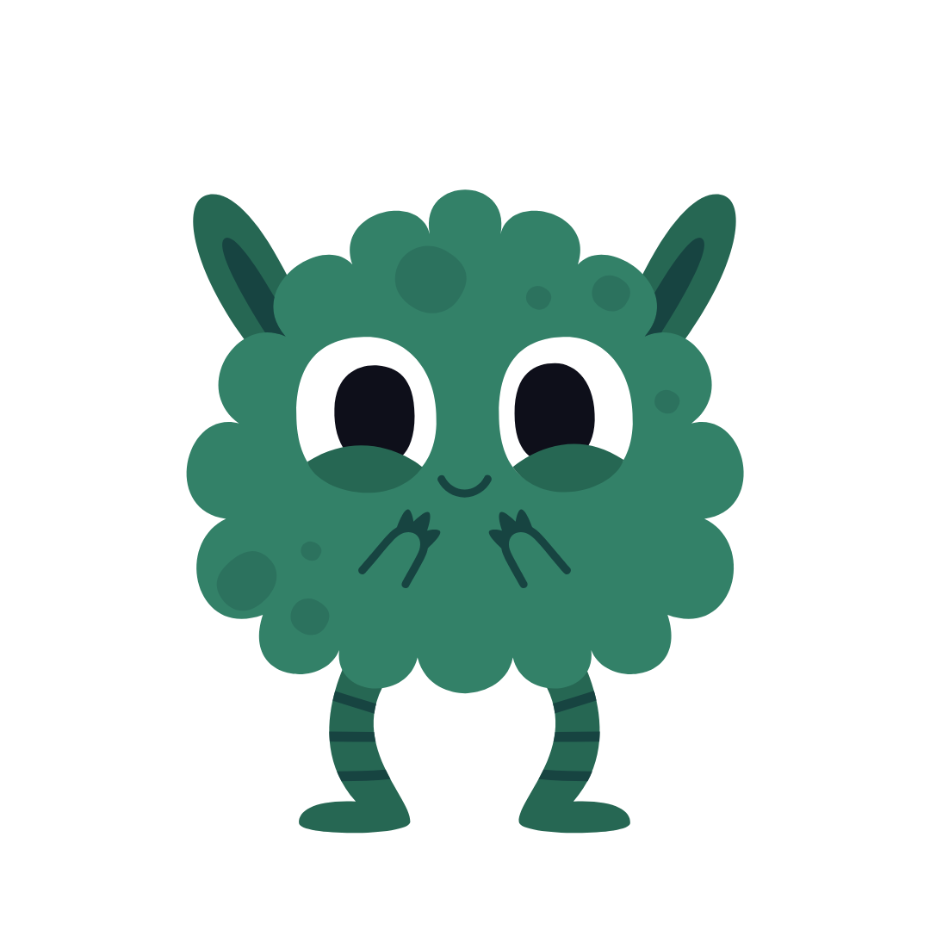
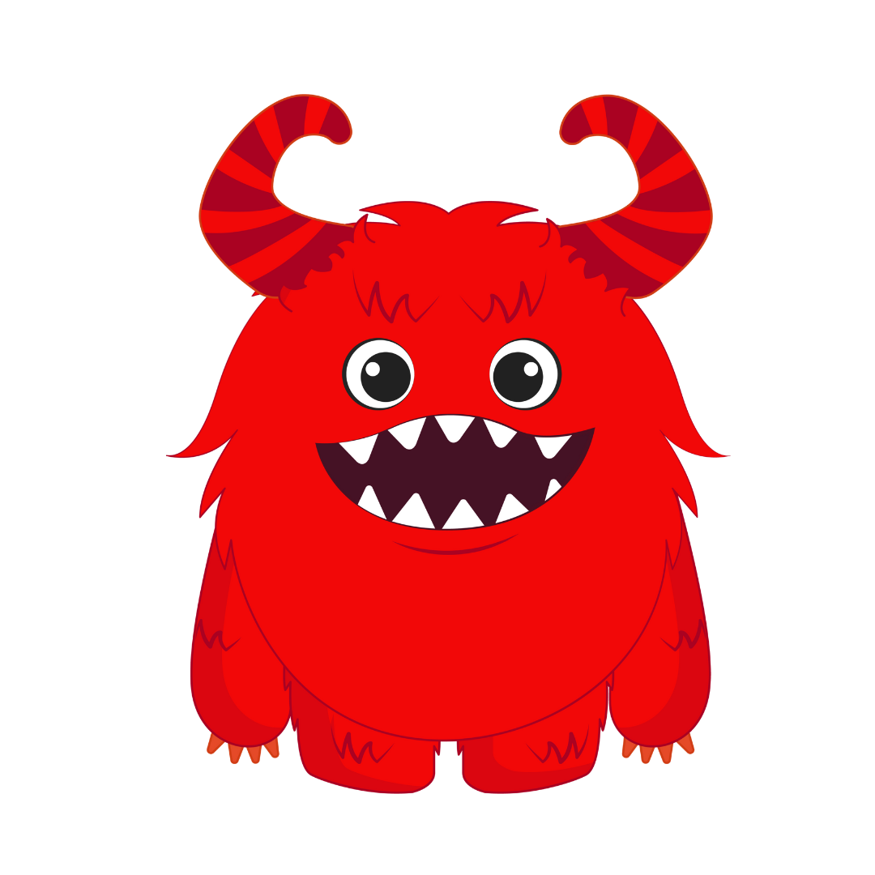
MA MA MOO Election
You have now become citizens of Ma Ma Moo Land.
It is a peaceful land, and this has allowed Mamamooians to develop a sophisticated style of communication.
Mamamooians only have 3 words in their language: ma, moo and ma-ma-moo.
They rely on non-verbal cues in order to communicate.

Slide 41
MA MA MOO Election
Round 1
The Local Elections
Battle it out in your teams. Who will you pick as your representative?
Round 2
The General Elections
Representatives from each team will now compete for leadership.
Do you have what it takes to lead the Maamaamooians?

Slide 42
Evaluate the performances!
Go back to your worksheet and tick off the different skills you tried in your speech.
Circle the skills you want to try next time!

Slide 43
Lesson 5A: Listening and responding

Slide 44
What does non-verbal communication mean to you?
Pick two of the strategies below and discuss why they are important with your partner.
Be prepared to share your ideas with the class.
Eye-contact
Volume
Posture
Gesture
Tone
Pace

Slide 45
Today’s plan
In a debate, it is important to respond to others, just like we did during Week 3’s lesson: the balloon debate.
The first step in doing that is careful listening, which we’re going to practice first.
We will then have a go at the skill of summarising ourselves!

Slide 46
PEE and summarising
Motion: That no-one should eat meat
Point: No-one should eat meat, because it’s wrong to kill animals.
Explanation: Some animals are our friends, like dogs and cats – other animals are just as important, and it’s not right to kill them.
Example: For example, cows and sheep can be as friendly and loving as dogs and cats.
Summary:
You said you love animals and you don’t eat them.
You said it’s wrong to kill animals, so we should never eat them.
Which summary is best?

Slide 47
PEE and summarising
Motion: Everyone should be taught cooking at school
Point: I think that all students should have to learn to cook in school…
Explanation: … because it’s a really important skill that everybody needs – we all need to eat!
Example: For example, my brother has just gone to university, and he has to cook for himself every day!
Summary:
You said cooking is a great school subject.
You said everyone needs to learn cooking in school as it is an
important life skill.
Which summary is best?

Slide 48
Let’s do one together
Summary:
You said _________________________________________________

Slide 49
Your turn…
1
2
3
4
5
P: Primary school children should be allowed to walk to school on their own…
E: … because they can be just as responsible as older children.
E: For example, sometimes you even see older children being silly near roads!
P: We should not have to wear uniform at school…
E: …because it would be nice to wear our own clothes.
E: For example, I would like to wear my red hat.
P: Fizzy drinks should not be allowed in school…
E: …because they’re unhealthy and rot your teeth.
E: For example, each can of coca cola contains 7 whole teaspoons of sugar!
P: My point in the debate is that if we choose our own books to learn from, we’ll have more fun at school.
E: Books we’ve chosen ourselves will be exciting and fun!
E: For example, I would love to read Diary of a Wimpy Kid.
P: We should not have a queen anymore. Instead, we should elect our rulers.
E: At the moment the queen is in charge of everything, but it would be better if we could choose the best rulers instead.
E: For example, in lots of other countries they don’t have a king or a queen

Slide 50
Indicative language
“My point is…”
“In conclusion…”
“This proves/I will prove…”
“I am arguing that…”
“The most important thing is…”

Slide 51
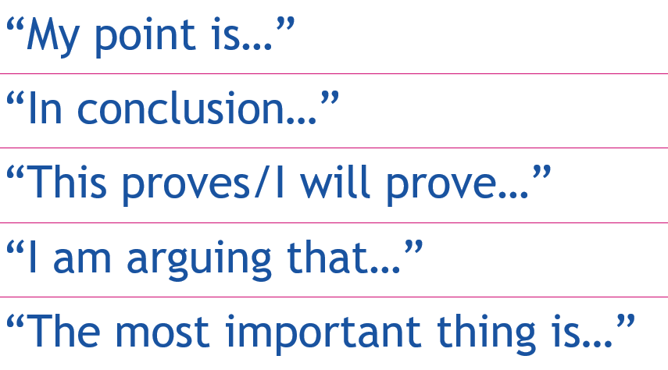
Now, we have to respond…
“ You said robots would be a good replacement for teachers as they would always treat students fairly.
But I disagree with you because fairness is not the most important quality teachers should have.
I am arguing that robots lack other human skills that are essential in teaching, such as empathy. ”

Slide 52
Plenary – example points
Dogs are better than cats because they are more playful and energetic.
We should have PE every day because running around and getting exercise is good for you.
Pupils should elect their own Headteacher because they are the ones who’ll be receiving the lessons, so they should choose the best person to teach them.
We should ban exams because they make children stressed and anxious.
We should ban zoos because it’s better to keep animals in their natural habitat, not in cages.
We should teach videogames as a subject in school because they help children to learn about solving puzzles and games.
Children should have mobile phones because they could call someone in an emergency or if they ever got lost.
Footballers get paid too much money because all they are doing is kicking a ball around, not saving lives like doctors and nurses

Slide 53
Plenary – example points
Books are better than films because you can imagine the characters in your head, which is more creative.
Children should refuse to go to school on Fridays in protest against climate change, because it is they who will have to grow up to face the consequences of global warming.
We should ban cars from city centres because we should be encouraging more environmentally-friendly policies, like taking public transport, cycling, or walking.
It would be bad to be famous because the paparazzi would follow you everywhere, giving you no privacy.
Digital technology makes our lives better because we can talk to family and friends on the other side of the world.
We should all be vegetarian because it is cruel to kill and eat animals.
We should ban school uniforms because children should be able to express their personality through what their clothes, rather than dressing the same as everyone else.

Slide 54
Plenary
1. Your teacher will now give you a Point – it is your job to provide an Explanation and Evidence to back it up.
2. Swap your work with your partner. Have a look at their Point, Explanation and Evidence and summarise their ideas into one sentence.
3. Present your summaries to each other. Provide feedback to your partner and be prepared to share your work with the class.

Slide 55
Lesson 6A: Listening and responding, Part 2 and Introduction to argumentation

Slide 56
Match your Point, Example and Explanation with your summary…It’s hidden somewhere around the classroom!
Extension:
How effective is your summary? Could you improve it?

Slide 57
Today’s plan
In today’s lesson we’re going to build upon what we did last week.
We are all going to be involved in preparing some responses to arguments.
We are also going to learn about ‘rebuttal’: the term we use to describe our response to an argument we disagree with.

Slide 58
Developing rebuttal
Motion: We should get rid of zoos
P: We should ban zoos because it is cruel to keep animals in small cages…
E: … In the wild animals are free, and sometimes travel large distances over big areas of land like forests and grassy plains.
E: For example, some elephants travel as much as 50 miles a day!
You said it’s cruel to keep animals in zoos.
But I disagree because not all animals need to travel large distances – for example, I’ve seen animals like monkeys and lemurs in the zoo, and they are happy playing on the ropes and branches in their enclosure.
So I think we should not ban zoos – maybe instead we should just not have the really big animals like elephants if they are unhappy.

Slide 59
Developing rebuttal
Motion: That everybody should have a pet
P: Everyone should have a pet because it makes you more responsible
E: Pets need to be fed and taken for walks – you can’t forget about them or get bored, you must be responsible.
E: For example, I feed my hamster every day – it shows I am trustworthy and can be relied on.
You said that having a pet makes you more responsible.
But I disagree because in your example you are reliable and feed your hamster, but many other children do not remember to look after their pets. Their parents look after the pets.
So I think that having a pet doesn’t mean you are always more responsible.

Slide 60
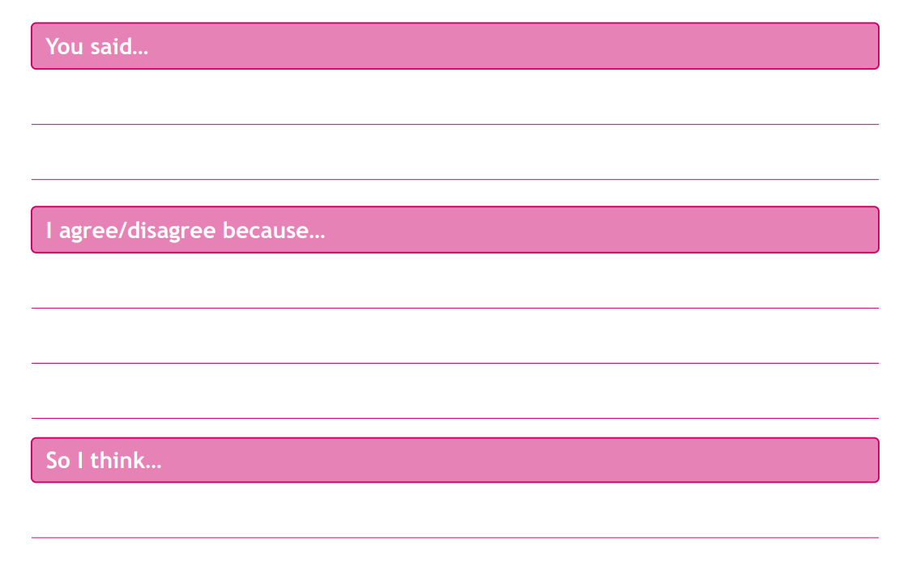
that having a pet makes you more responsible
in your example you are reliable and feed your hamster, but many other children do not remember to look after their pets. Their parents look after the pets.
Writing Frame!
that having a pet doesn’t mean you are always more responsible

Slide 61
Time to practice!
Each of you will have either an argument or response card. All those with an argument card will stand on one side of the room, and those with a response card will stand on the other side.
One pupil will read out their argument card. The pupil who thinks they hold the corresponding response card must raise their hand.
Pupils with their hands raised will read their cards. Then, as a class, identify which is the correct response card. Repeat this process until all cards have been matched.

Slide 62
Plenary
Get into pairs.
The argument cards will be collected, shuffled and redistributed one between two.
Write your own response card for the argument you have been given, using the response framework.
Share and evaluate examples as a class.

